Slide 1
COSE321 Computer Systems Design
Lecture 0. Course Introduction
Prof. Taeweon Suh
Computer Science & Engineering
Korea University

Slide 2
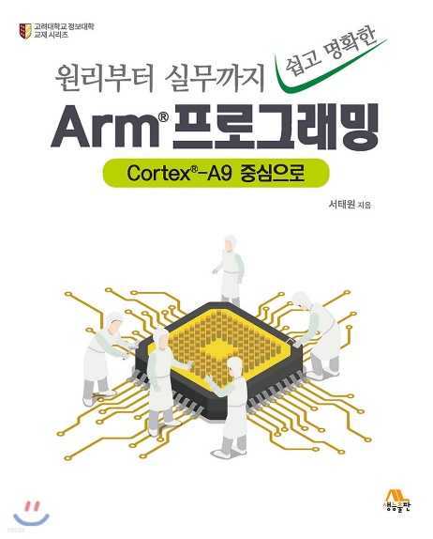
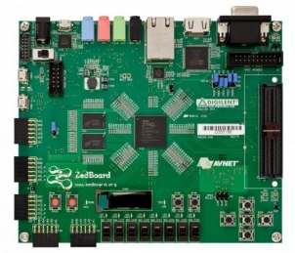
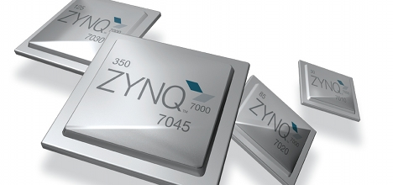

Course Information
Instructor
Prof. Taeweon Suh
References
원리부터 실무까지 쉽고 명확한 Arm 프로그래밍: Cortex-A9 중심으로
ARM Architecture & Technical Reference Manual (TRM)
Zedboard & Zynq-7000 TRM
(Zedboard has a Zynq-7000 device from Xilinx)
Prerequisites
Operating Systems (not strictly required)
Computer Architecture
Computer Logic Design
C-programming
Class web
http://esca.korea.ac.kr
Office hours
After class
By appointment at Aegineung Cafeteria 320
Contact Information
suhtw@korea.ac.kr
02-3290-2397
Zedboard
Zynq-7000
(from Xilinx)

Slide 3
Objective
Understanding of computer systems through hands-on labs
Software (ARM assembly & C) programming with Cortex-A9 based system
Basic ARM programming
Programming for I/O devices (GPIO, Timer & UART)
Interrupts & Exceptions
Cache & TLB manipulation
TEE (Trusted Execution Environment) with TrustZone
Hardware (Peripherals: GPIO and ?) design and integration into Cortex-A9 based system

Slide 4

TA (Teaching Assistant)
Teaching Assistant: 서상현 (Sanghyeon Seo)
MS student in Embedded Computing Lab at Aegineung Cafeteria 307
Email: tjtkdgus45@korea.ac.kr
Tel: 010-2267-7336 (cell)
02-3290-2685 (office)

Slide 5
Abstraction
Abstraction helps us deal with complexity
Hide lower-level detail

Slide 6

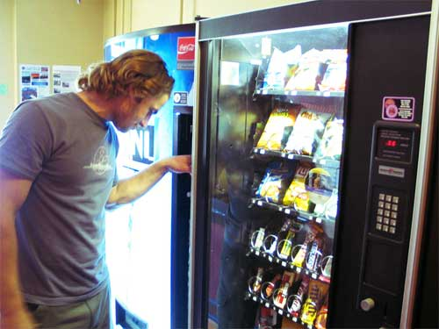
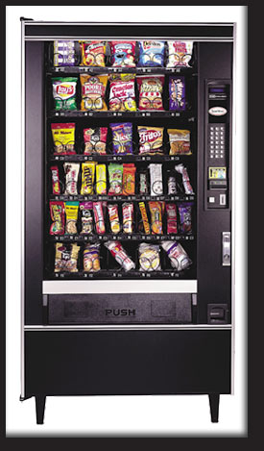
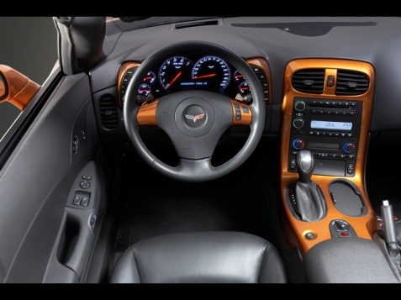
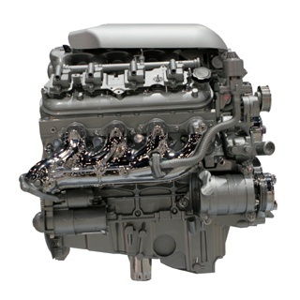
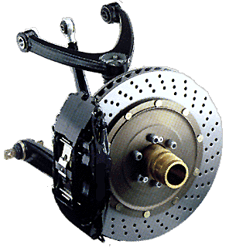
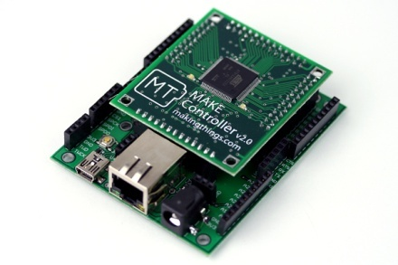
Abstraction Analogies
Driver
Customer
Abstraction layer
Abstraction layer
Machine Details
Machine Details
Combustion Engine in a car
Break system in a car
Hardware board in a vending machine

Slide 7




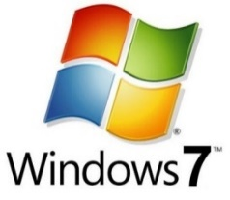



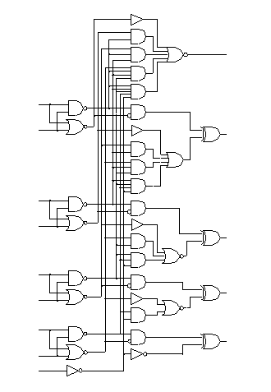
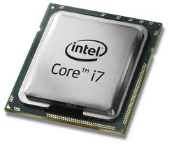
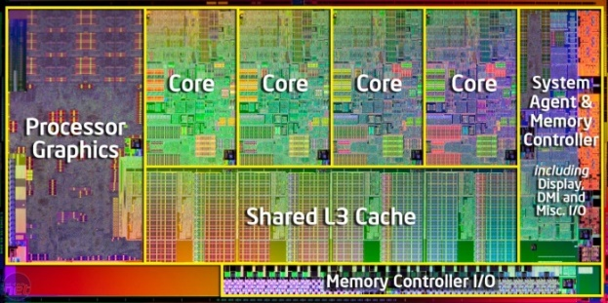
Abstractions in Computer
Programming using APIs
Provides APIs (Application Programming Interface)
Operating Systems
Instruction Set Architecture (ISA)
Assembly language
or
Machine language
Hardware Implementation
(x86)

Slide 8

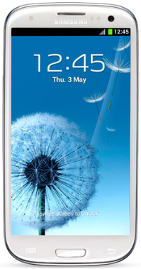
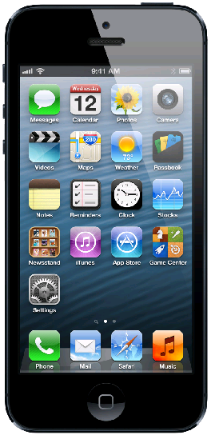


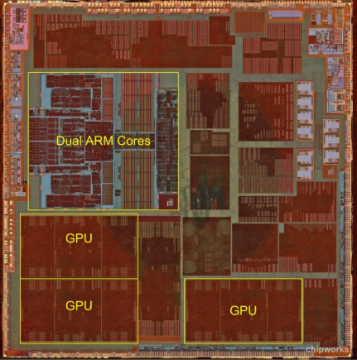
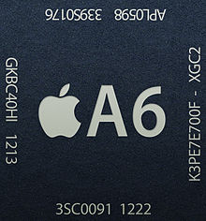
Abstractions in Smartphones
Application Programming using APIs
Operating Systems
Instruction Set Architecture (ISA)
Hardware Implementation
(ARM)
http://arstechnica.com/apple/2012/09/detailed-analysis-of-apple-a6-core-reveals-layout-done-by-hand/

Slide 9
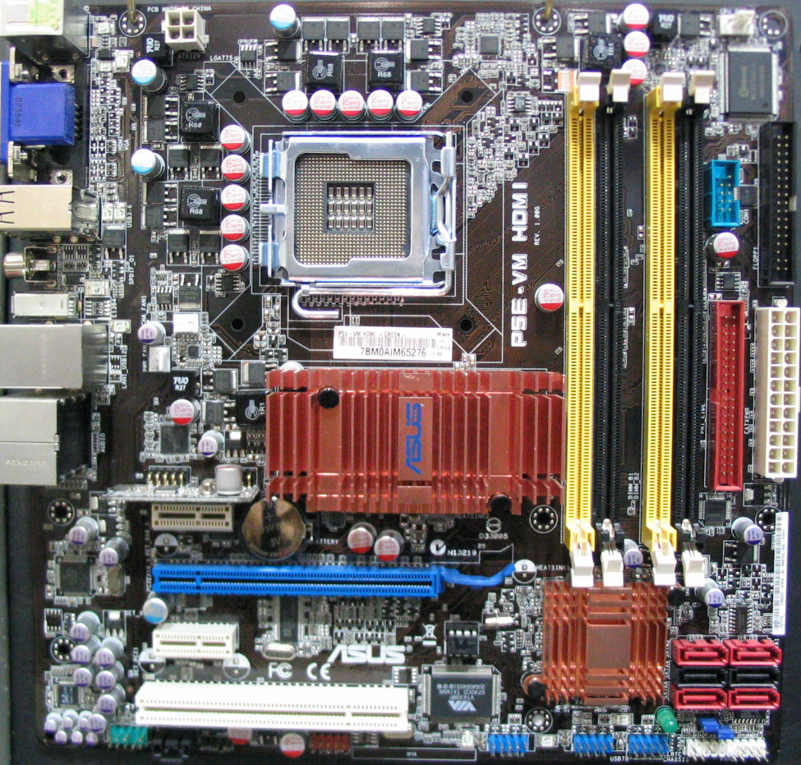
A Computer System (~ 2010)
CPU
Main Memory
FSB
(Front-Side Bus)
Graphics card
North Bridge
Peripheral devices
DMI
(Direct Media I/F)
South Bridge
Hard disk
USB
PCIe card
But, don’t forget the big picture!

Slide 10
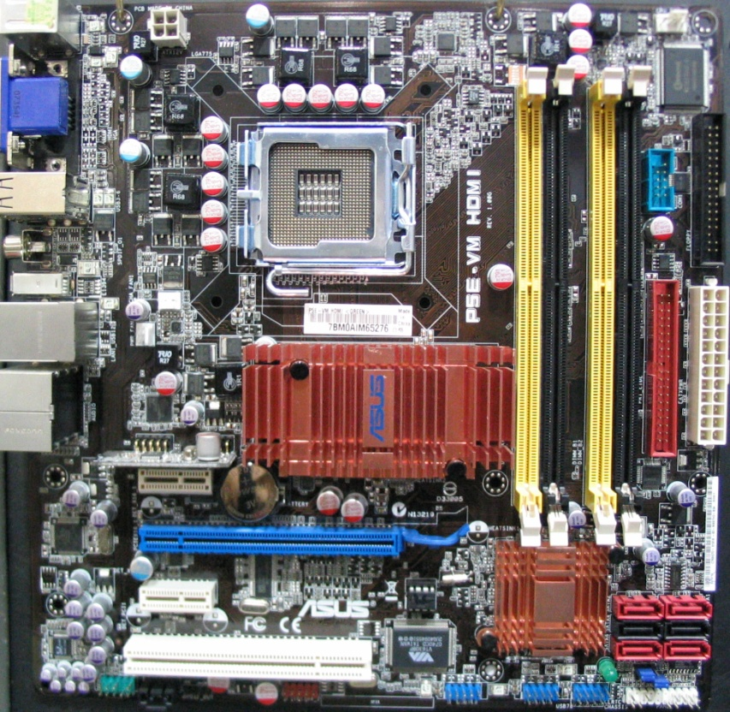

Evolution of Computer Systems
Core 2 Duo – based Systems
Core i7– based Systems
CPU
Main Memory
(DDR2)
CPU
Main Memory
(DDR3)
FSB
(Front-Side Bus)
Quickpath (Intel) or
Hypertransport (AMD)
North Bridge
IOH (Input/Output Hub)
South Bridge
South Bridge
DMI
(Direct Media I/F)
DMI
(Direct Media I/F)
Keep in mind that CPU and computer systems are evolving at a fast pace

Slide 11
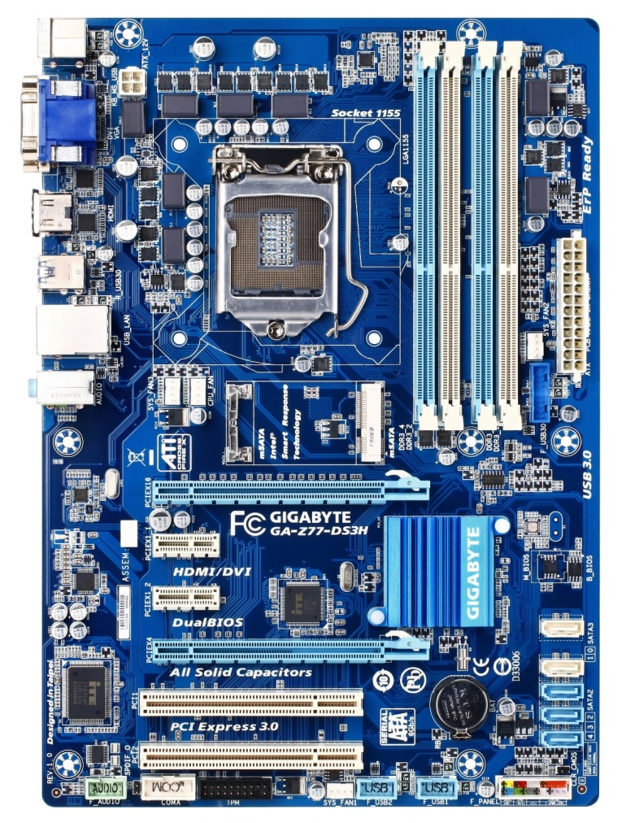
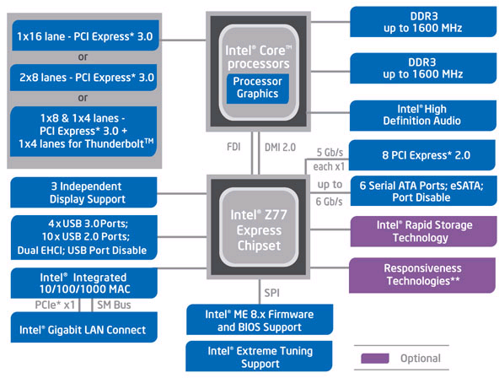
3rd Gen Core i7 (Ivy Bridge)-based Systems
FDI: Flexible Display Interface
DMI: Direct Media Interface
SPI: Serial Peripheral Interface
SMBus: System Management Bus
Notes:
FDI or Flexible Display Interface is an interconnect created by Intel in order to allow the communication of the HD Graphics integrated GPU found on supported CPUs with the PCH southbridge where display connectors are attached. It provides a path between an Intel processor and an Intel southbridge on a computer motherboard which carries display data from the graphics controller (North Display) of the Intel processor package to the display connectors attached at some PCH (South Display) versions.

Slide 12
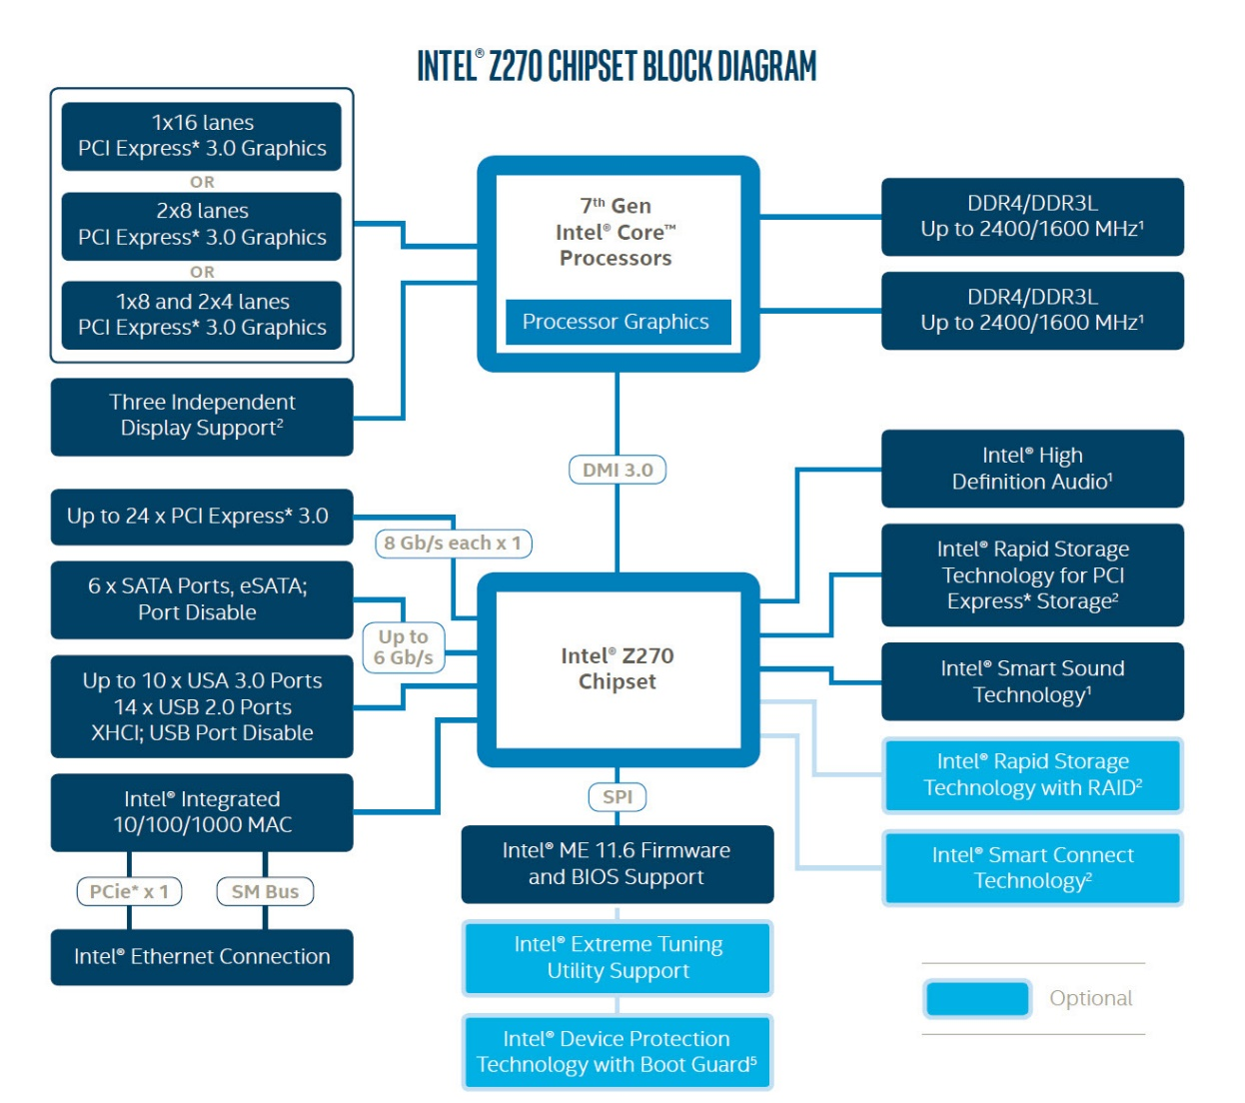
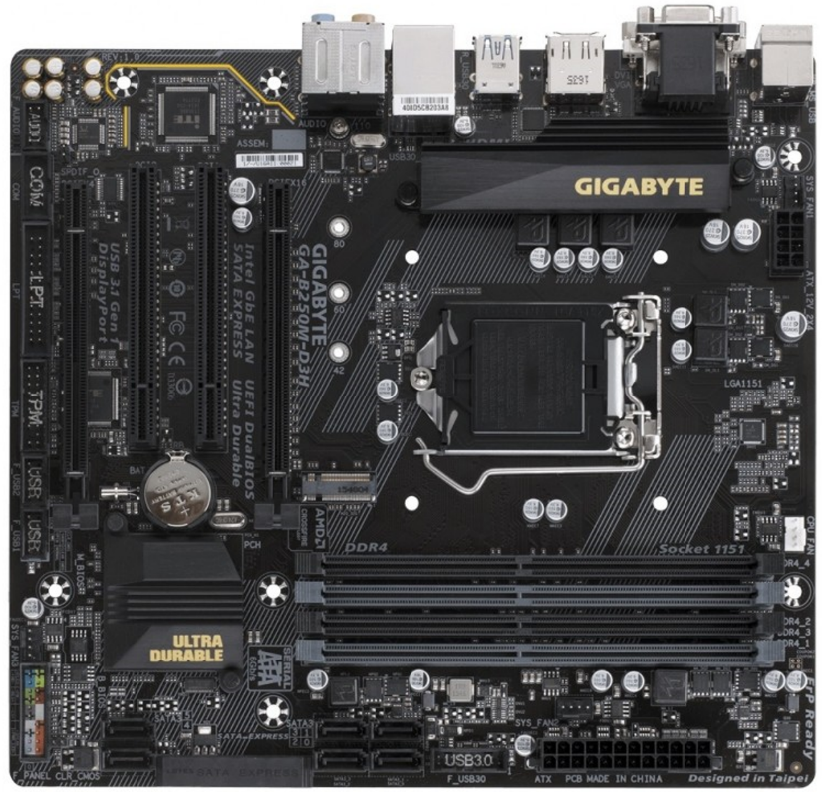
7th Gen Core i7 (Kaby Lake)-based Systems
FDI: Flexible Display Interface
DMI: Direct Media Interface
SPI: Serial Peripheral Interface
SMBus: System Management Bus
http://www.pcworld.com/article/3152701/computers/official-intel-7th-gen-kaby-lake-review-one-big-change-makes-up-for-smaller-ones.html
Notes:
FDI or Flexible Display Interface is an interconnect created by Intel in order to allow the communication of the HD Graphics integrated GPU found on supported CPUs with the PCH southbridge where display connectors are attached. It provides a path between an Intel processor and an Intel southbridge on a computer motherboard which carries display data from the graphics controller (North Display) of the Intel processor package to the display connectors attached at some PCH (South Display) versions.

Slide 13
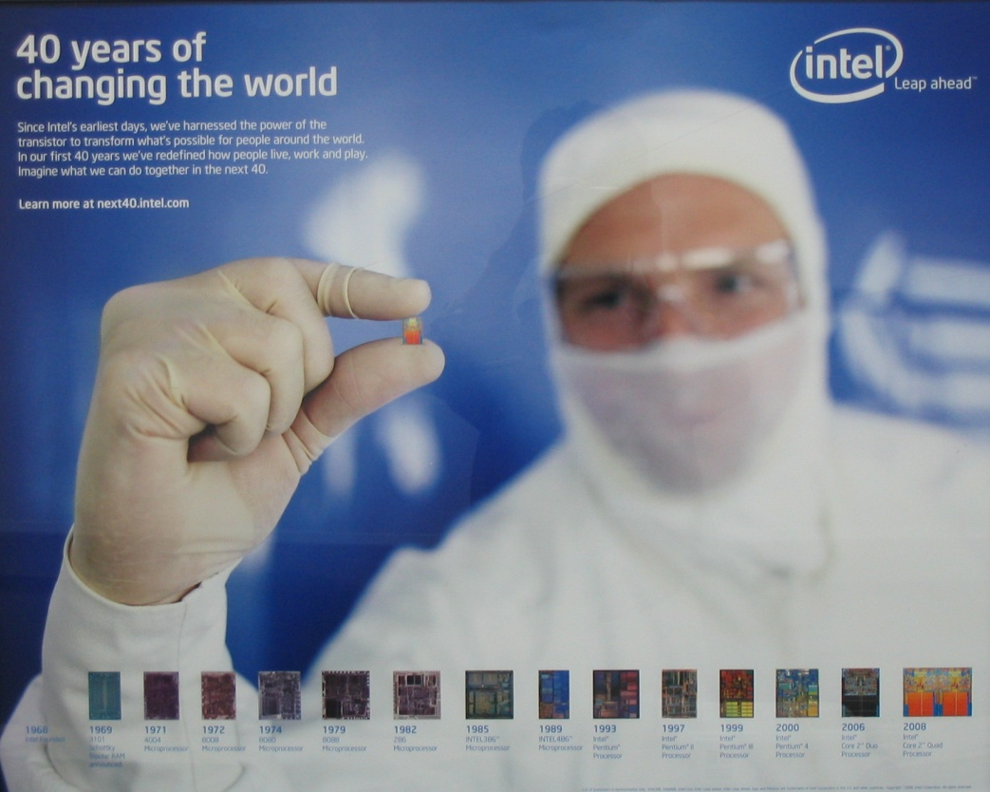
x86 History (as of 2008)

Slide 14
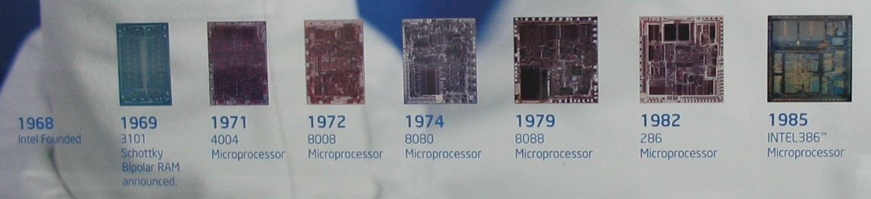
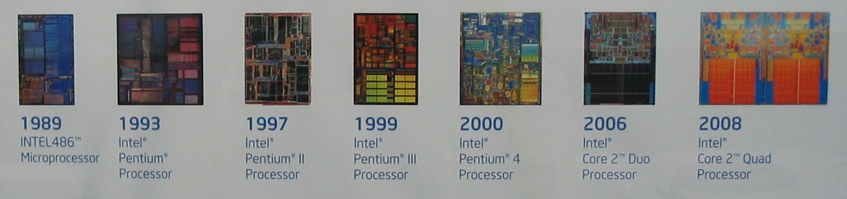
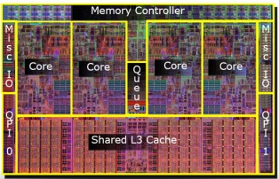
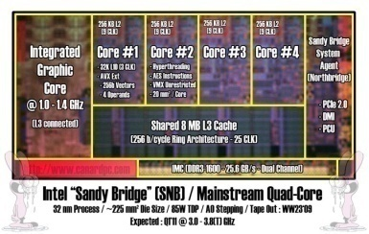
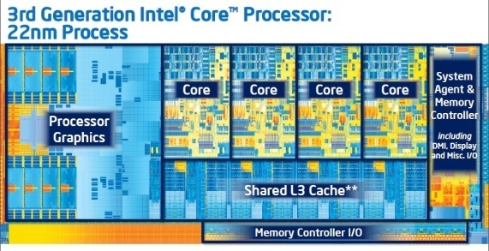
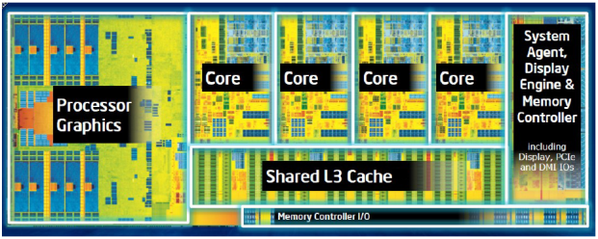
x86 History (Cont.)
4-bit
8-bit
16-bit
32-bit (i386)
32-bit (i586)
32-bit (i686)
64-bit (x86_64)
2009
2011
1st Gen. Core i7
(Nehalem)
2nd Gen. Core i7
(Sandy Bridge)
2012
2013
3rd Gen. Core i7
(Ivy Bridge)
4th Gen. Core i7
(Haswell)

Slide 15
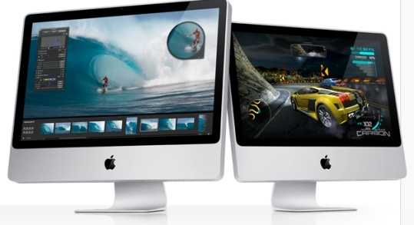
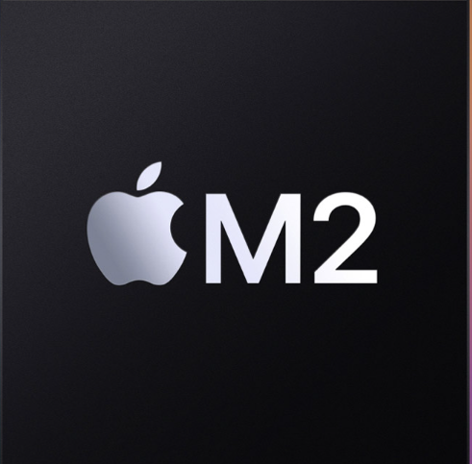
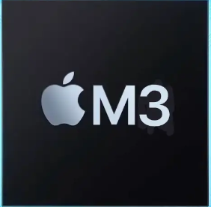
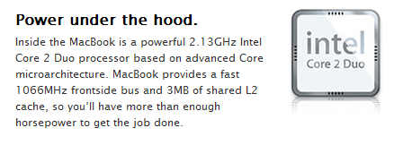
x86?
What is x86?
Generic term referring to processors from Intel, AMD and VIA
Derived from the model numbers of the first few generations of processors:
8086, 80286, 80386, 80486 → x86
Now it generally refers to processors from Intel, AMD, and VIA
x86-16: 16-bit processor
x86-32 (aka IA32): 32-bit processor * IA: Intel Architecture
x86-64: 64-bit processor
Intel takes about 80% of the PC market and AMD takes about 20%
Apple has also been introducing Intel-based Mac from Nov. 2006
From 2020, Apple is replacing Intel chip with Arm-based in-house M1, M2, and M3
* aka: also known as
https://www.apple.com/macbook-pro-13/

Slide 16
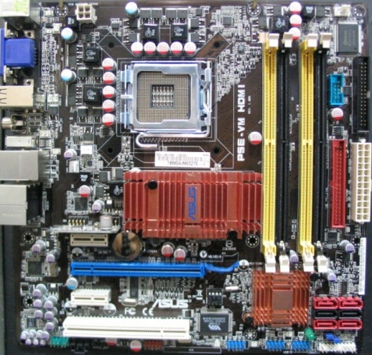
Chipset
We call North and South Bridges as Chipset
Chipset has many PCIe devices inside
North Bridge
Memory controller
PCI express ports to connect Graphics card
http://www.intel.com/Assets/PDF/datasheet/316966.pdf
South Bridge
HDD (Hard-disk) controller
USB controller
Various peripherals connected
Keyboard, mouse, timer etc
PCI express ports
http://www.intel.com/Assets/PDF/datasheet/316972.pdf
Note that the landscape is being changed!
For example, memory controller is integrated into CPU

Slide 17
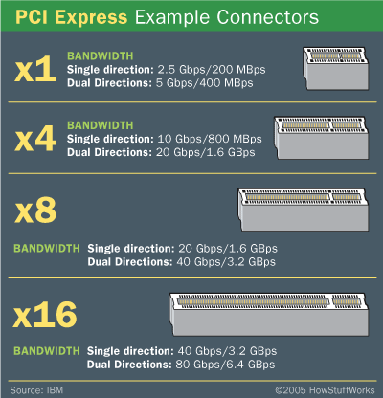
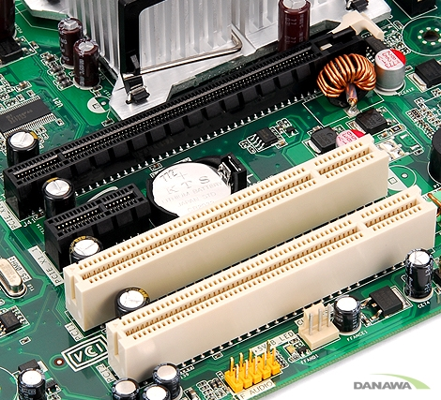
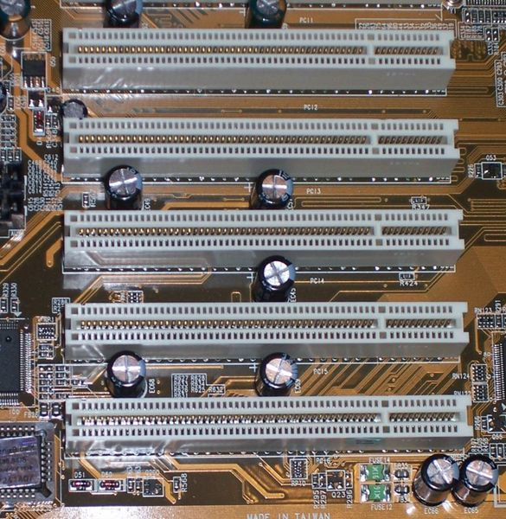
PCI, PCI Express Devices
PCI (Peripheral Component Interconnect)
Computer bus connecting all the peripheral devices to the computer motherboard
PCIe (PCI Express)
Replaced PCI in 2004
Point-to-point connection
PCI express slots
PCI express slot x16
PCI slot
http://www.pcisig.com/specifications/pciexpress/

Slide 18
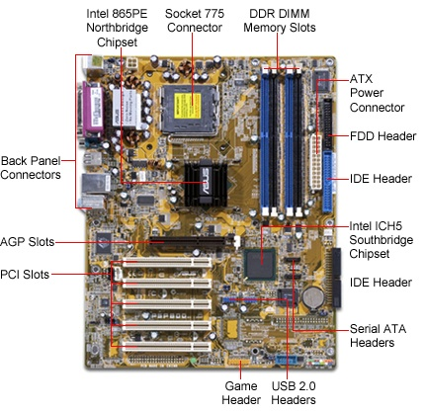
An Old GP Computer System Example

Slide 19
PCI Express Slots in GP Systems
PCI express slot

Slide 20
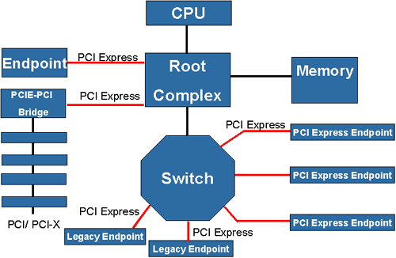
GP Computer System in terms of PCIe
North Bridge
South Bridge

Slide 21
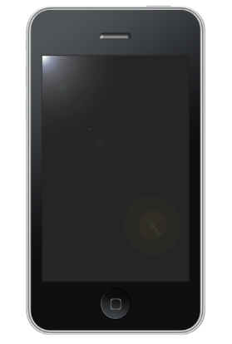
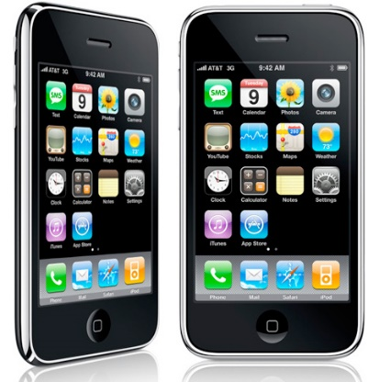
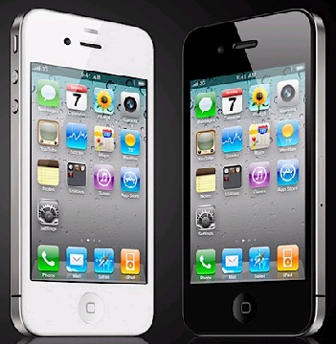
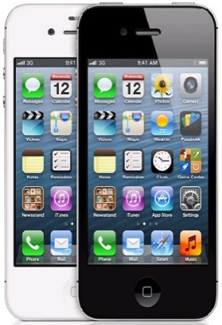
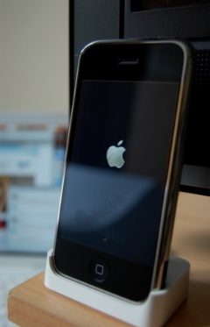
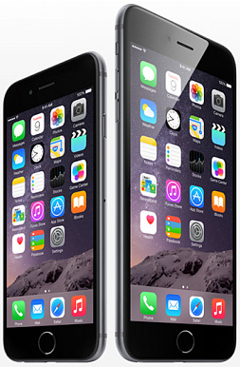
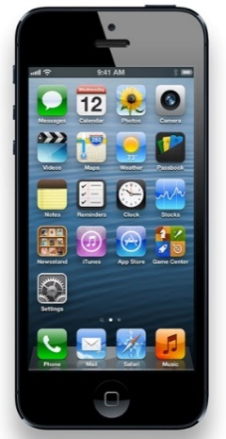
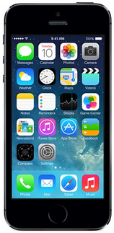
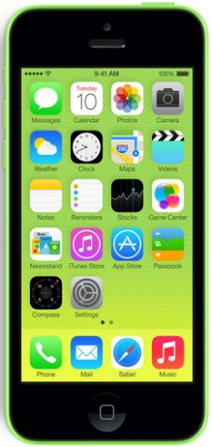
iPhone Generations
Original iPhone
(iPhone 2G)
iPhone 3G
iPhone 3GS
iPhone 4S
iPhone 4
June 2007
June 2008
June 2009
June 2010
Oct. 2011
iPhone 6 iPhone 6 Plus
iPhone 5
iPhone 5c iPhone 5s
Sep. 2012
Sep. 2013
Sep. 2014
http://apple.wikia.com/wiki/IPhone_3G
http://en.wikipedia.org/wiki/History_of_the_iPhone

Slide 22
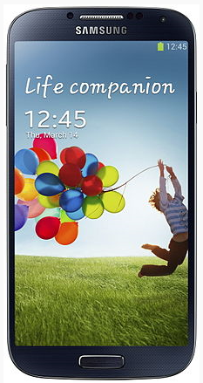





Galaxy S Series
Galaxy S
Android 2.3.6
Single-core Cortex A8
Galaxy S2
Android 2.3 Gingerbread
Dual-core Cortex A9
Galaxy S3
Android 4.0.4 Ice Cream Sandwich
Dual-core Cortex A9
Galaxy S4
Android 4.2.2 Jelly Bean
(Quad-core Cortex A15 & Quad-core Cortex-A7) or Quad-core Krait 300 (Qualcomm Snapdragon)
April 2013
June 2010
May 2011
May 2012
Galaxy S5
Android 4.4.2 KitKat
(Quad-core Cortex A15 & Quad-core Cortex-A7) or Quad-core Krait 400 (Qualcomm Snapdragon)
Galaxy S6 Edge
Android 5.0 Lolipop
Quad-core Cortex A53 & Quad-core Cortex-A57
April 2014
March 2015
http://phandroid.com/2012/07/17/samsung-galaxy-s-blaze-4g-gets-quick-maintenance-upgrade/
http://www.phonearena.com/news/Is-Android-4.2.2-the-end-of-the-line-for-the-Samsung-Galaxy-S-II-and-Samsung-GALAXY-Note_id41162

Slide 23




iPhone 4 (Sep. 2010) Teardown
http://www.ifixit.com/Teardown/iPhone-4-Teardown/3130/1
http://news.cnet.com/8301-13924_3-20006904-64.html
http://www.pcmag.com/encyclopedia/term/62034/antennagate
GSM (Global System for Mobile communications): 2G, 3G, 4G ..
UMTS (Universal Mobile Telecommunications Systems): one of 3G technologies being developed into 4G

Slide 24



iPhone 4 (Sep. 2010) Teardown
512MB Mobile DDR
Audio Codec (Cirrus Logic)
Samsung flash memory (32GB): K9PFG08
A4 Processor (ARM Cortex A8) designed by Apple manufactured by Samsung
GSM and more
GSM (Global System for Mobile communications): 3G

Slide 25



iPhone 4 (Sep. 2010) Teardown
Accelerometer detects when the user has rotated the device from portrait to landscape, then automatically changes the contents of the display accordingly
Proximity sensor detects when you lift iPhone to your ear and immediately turns off the display to save power and prevent inadvertent touches until iPhone is moved away
Ambient light sensor automatically adjusts the display’s brightness to the appropriate level for the current ambient light, enhancing the user experience and saving power at the same time

Slide 26



iPhone 5 (Sep. 2012) Teardown
Accelerometer
Touchscreen controller
A6 application processor, based off the ARMv7 ISA
1GB Elpida LP (Low Power) DDR2 integrated according to Chipworks
LTE modem
16GB NAND Flash from Hynix
Wi-Fi module
3-axis gyroscope
http://www.ifixit.com/Teardown/iPhone+5+Teardown/10525/2

Slide 27

iPhone 5S (Sep. 2013)
First smartphone with 64-bit ARM
A7: Apple-designed 64-bit (ARMv8-A) dual-core CPU
https://www.ifixit.com/Teardown/iPhone+5s+Teardown/17383
https://en.wikipedia.org/wiki/Apple_A7

Slide 28


iPhone 7 (Sep. 2016) Teardown
A10 Fusion application processor, based off the ARMv8 ISA
2GB Samsung LPDDR4
Wi-Fi module
32GB NAND Flash from SK Hynix
NFC Controller
A10: Apple-designed Quad-core SoC
3.3 billion transistors with TSMC 16nm FinFET
Two 2.34GHz ARMv8-A
Two energy-efficient 64-bit cores
Barometric Pressure Sensor
https://www.ifixit.com/Teardown/iPhone+7+Teardown/67382

Slide 29


Apple A12 Bionic (2018)
Armv8.3-A
6 (2+4) cores based on Big.LITTLE
7 billion transistors
7nm technology
NPU
5 TOPS
7% chip area
Roughly $5.10
https://www.eetimes.com/putting-ai-into-the-edge-is-a-no-brainer-and-heres-why/#
https://www.ifixit.com/Teardown/iPhone+XS+and+XS+Max+Teardown/113021

Slide 30

Die Rendering Assumption from Skyjuice - A16 Bionic vs A15 Bionic -
(iPhone 14)
A16 Bionic
Sep. 2022
16B transistors
Armv8.6-A
6 cores (2 performance + 4 efficiency)
16MB L2 for Everest
4MB L2 for Sawtooth
24MB SLC
(iPhone 13)
A15 Bionic
Sep. 2021
15B transistors
Armv8
6 Arm cores (2 performance + 4 efficiency)
12MB L2 for Avalanche
4MB L2 for Blizzard
32MB SLC
https://en.wikipedia.org/wiki/Apple_A15
Everest: High-performance core,
Sawtooth: energy-efficient core
SLC: System Level Cache
https://en.wikipedia.org/wiki/Apple_A16
https://www.angstronomics.com/p/apple-a16-die-analysis

Slide 31


Galaxy S3 (May 2012) Teardown
Samsung 16GB eMMC (MultiMediCard)
+ 64MB NAND Flash
Intel Wireless Processor
Exynos 4412: Quad-core A9 with 1GB DDR2
http://www.samsung.com/
http://www.ifixit.com/Teardown/Samsung-Galaxy-S-III-Teardown/

Slide 32

Exynos 4412 Block Diagram
MFC: Multi Format Codec
PoP: Package-on-Package
Notes:
What is PoP Memory?
DECEMBER 19, 2009
Package-on-Package or (PoP) memory was created as a way to reduce the physical size of the memory sub-system on a single board computer. The basic idea is to stack two BGA devices one on top of the other as shown above.
PoP Memory has Several Advantages Including:
More reliable manufacture because the memory sub-system can be assembled separately from the final system.
Higher memory cycle speeds due to shorter connection lengths.
Small size
This type of memory is used in handsets and other types of portable devices and is also making it’s way into mid-level products as well.
Disadvantages Include:
BGA assemble issues, can only re-ball the part a limited number of times then it must be scrapped. So, for example, if the RAM portion fails, the FLASH could be de-soldered and re-soldered to a working RAM module, but only a limited number of times.
Test issues – BGA packages do not allow access to device pins once the device is soldered down. In the case of a PoP module, since the top module is soldered to the bottom, there is no way to access the pins. Typically JTAG boundary-Scan tools can be used to test in this configuration.

Slide 33



Galaxy S4 (April 2013) Teardown
Snapdragon 600 has Krait 300 CPU
Krait has architectural similarities to ARM Cortex-A15 -- Wikipedia
http://www.samsung.com/
http://www.ifixit.com/Teardown/Samsung+Galaxy+S4+Teardown/13947/2

Slide 34

Galaxy S4 (April 2013) Teardown
Exynos 5 Octa (Exynos 5410): quad-core Cortex-A15 and quad-core Cortex-A7 -- Wikipedia
http://www.techinsights.com/inside-samsung-galaxy-s4/

Slide 35


Galaxy S8 (April 2017) Teardown
Snapdragon 835 (spec?)
4GB LPDDR4 RAM
64GB Toshiba NAND Flash
http://www.techinsights.com/inside-samsung-galaxy-s4/

Slide 36

Experiment Environment: Zedboard (Front)
USB JTAG
USB UART
HDMI Transmitter
(ADV7511, Analog Devices)
USB OTG
512MB DDR3
= 2 x 2Gbit
Xilinx Zynq-7000
(dual-core Cortex-A9s)
MT41J128M16HA = 2Gb DDR3 with 16bit interface
USB OTG (On-The-Go) is a specification that allows USB devices (such as mobile phones) to act as a host, allowing other USB devices like a USB flash drive, mouse or keyboard to be attached to them
JTAG (Joint Test Action Group) is the common name for the IEEE 1148.1 Standard Test Access Port and Boundary-Scan Architecture

Slide 37

Experiment Environment: Zedboard (Back)
4-bit SPI (Quad-SPI) serial NOR flash
Audio Codec (ADAU1761, Analog Devices)
33.333MHz clock for PS
SD (Secure Digital) Card
100MHz clock for PL
The PS can generate up to 4 PLL based clocks for the PL
SPI Flash can be used to initialize the PS subsystem and to configure the PL subsystem (bitstream)
SPI: Serial Peripheral Interface named by Motorola

Slide 38


Zynq-7000
Hardware system will be provided
Software written in Assembly (and C) is downloaded to OCM or DDR
Processing System (PS)
Programmable Logic (PL)
Block RAMs in purple
XC7Z020-1CLG484C

Slide 39
Grading Policy
Exams (70%)
Midterm: 30%
Final: 40%
Assignments: 30%
Extra credit: 10%
Mini-project: simple OS (operating system) design
Fail rules
You will be given an “F” if you miss classes more than 3 times
2 late show-ups will be counted as 1 absence

Slide 40
Backup

Slide 41
iPhone 5S (Sep. 2013)
First smartphone with 64-bit ARM
A7: Apple-designed 64-bit (ARMv8-A) dual-core CPU
https://www.ifixit.com/Teardown/iPhone+5s+Teardown/17383
https://en.wikipedia.org/wiki/Apple_A7

Slide 42













Smartphone War
http://www.sleetherz.com/2011/10/smartphone-war-in-fatal-three-way-iphone-4s-vs-droid-razr-vs-galaxy-nexus/

